Slide 1


TRIP PLANNER
By Toronto Coders

Slide 2
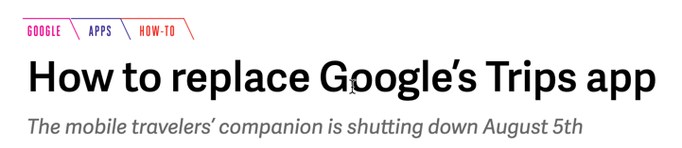


Slide 3
Feature List
Sl No | Feature | Release
1 | Search for Low Fare flights | Pilot
2 | Search for Points of Interest in Destination | Pilot
3 | Save favorite offers | Pilot
4 | Register an account and retrieve saved offers | After VC funding ☺
5 | Track price history | After VC funding ☺
6 | Book your flights and attractions | After Google buys our app
7 | Check-in and store Boarding passes | After Google buys our app

Slide 4

Unni
SARNEET
MANJYOT

